Slide 1

Data Driven Applications
Web Applications
Data Access – PHP and MySQL
User Interaction
Lecture 2

Slide 2
Learning Outcomes (L01/02)
You will be able to describe and use the following
Make a connection to a DB table using PHP and native MySQLi connection class
Create and execute a query in SQL and PHP
Display results of a DB query in a web page
Structure the website using CSS (bootstrap) and MVC

Slide 3
Setup
Make sure your Apache server is running – check your XAMPP control panel
In your htdocs folder make sure there is a subfolder for this topic
Eg ..C:/xampp/htdocs/K00999999/T02
Download and unzip the code for this lecture to this folder
Start NETBEANS
Open the netbeans project for this lecture at this location

Slide 4
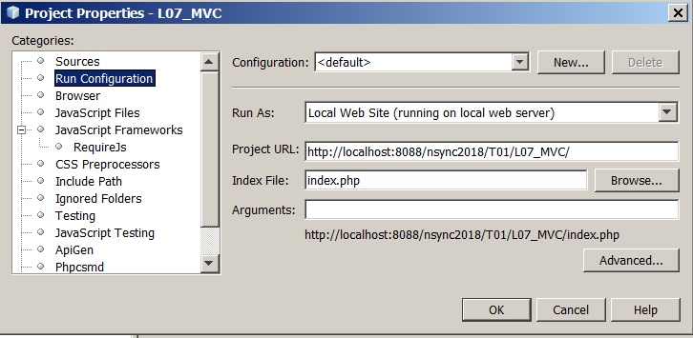
Configure NETBEANS project Properties
Right click on the project, select PROPERTIES/RUN CONFIGURATION
Set the PROJECT URL and index file to the correct one for your setup

Slide 5
Setting up MySQL database
To run these examples you will need a database set up
Restore the database that was provided as part of the PHP project you have just unzipped.
See the DATABASE folder

Slide 6
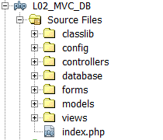
Website structure
The website files are structured as follows:
Style Sheets
Application
Configuration/Globals
Class Library
Database backup
MVC
HTML form
templates

Slide 7
index.php
This is the main application entry point
It loads all the required class libraries
It loads the global configuration files.
It creates and loads the main controller

Slide 8
Controller
Just one controller - MainController.php is the main controller
It loads the Home model and view when first loaded by default
It processes the ‘pageID’ choices that are passed through the URL to the get method

Slide 9
Models
There are two models used in this application – both are loaded by the mainController when a page selection is made (pageID)
Home: This model prepares menus and content for the home view based on whether a user is logged on or not.
Student: This model prepares menus and content for 2 pageIDs
student_query - generates a query form
student_query_result – generates a query form and query result

Slide 10
Views
Views are basically empty HTML templates
View content is prepared in the associated model and passed to the view via the controller as an array called $data
Both views use bootstrap CSS page styling
There are 2 views
view_3_panel : – divided into 3 sections with a menu bar along top
view_2_panel: divided into 2 sections with a menu bar along top. The two sections are used to present a query form and results results depending on the user action.

Slide 11
.htaccess
.htaccess – is a special file used by the Apache webserver
When a file/resource is requested from a folder through a URL – Apache first reads .htaccess
Instructions can be placed in .htaccess to inform Apache how the request should be handled
In our example the only instruction we have in all the SUB FOLDERS in our application is ‘deny from all’
This means that no-one can access any files in the application sub-folders – any attempt to access any subfolder resource will result in an Error 403 – Access Forbidden error from the server
This is an anti hacking/website protection measure

Slide 12
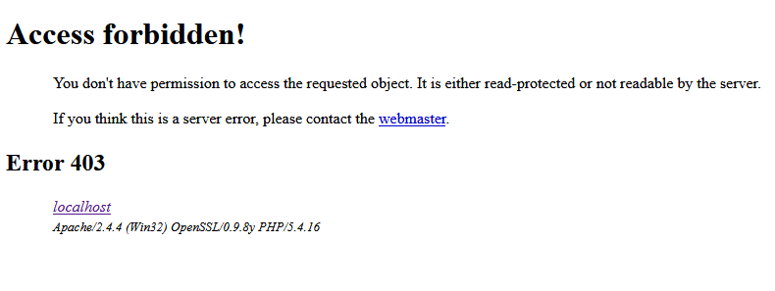
.htaccess
Error 403 – Access Forbidden error from the server
This is an anti hacking/website protection measure

